Slide 1
Apache Spark
Apache Spark is a cluster computing platform designed to be fast and general purpose.
On the speed side, Spark extends the popular Mapreduce model to efficiently support more types of computations, including interactive queries and stream processing.
On the generality side, Spark is designed to cover a wide range of workloads that previously required separate distributed systems, including batch applications, iterative algorithms, interactive queries, and streaming.
Spark is designed to be highly accessible, offering simple APIs in Python, Java, Scala, R and SQL, and rich built-in libraries.
Spark itself is written in Scala, and runs on the Java Virtual Machine (JVM).

Slide 2
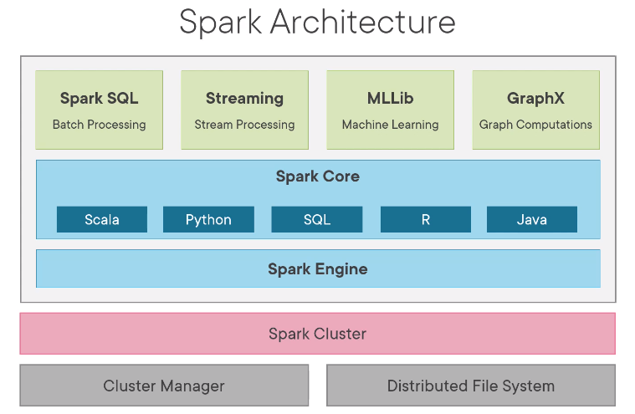
The Spark stack
Spark Core: Spark Core contains the basic functionality of Spark, including components for task scheduling, memory management, fault recovery, interacting with storage systems, and more. Spark Core is also home to the API that defines resilient distributed datasets (RDDs).
Spark SQL : Spark SQL is Spark’s package for working with structured data. It allows querying data via SQL as well as the Apache Hive variant of SQL, HQL.
Spark Streaming : Spark Streaming is a Spark component that enables processing of live streams of data.
Mllib : Spark comes with a library containing common machine learning (ML) functionality, called MLlib. MLlib provides multiple types of machine learning algorithms, including classification, regression, clustering, and collaborative filtering, as well as supporting functionality such as model evaluation and data import.
GraphX : GraphX is a library for manipulating graphs (e.g., a social network’s friend graph) and performing graph-parallel computations.
Cluster Managers : Under the hood, Spark is designed to efficiently scale up from one-to-many thousands of compute nodes. To achieve this while maximizing flexibility, Spark can run over a variety of cluster managers, including Hadoop YARN, Apache Mesos, and a cluster manager included in Spark itself as Standalone Scheduler.

Slide 3
Core Spark Concept
Spark uses distributed datasets stored in HDFS or any supported storages (e.g. S3)
Every Spark application consists of a driver program that launches various parallel operations on a cluster. The driver program contains application’s main function.
Driver programs access Spark through a SparkContext object, which represents a connection to a computing cluster.
Once SparkContext initiated, it is used to build logical Directed Acyclic graph of RDDs. Then Logical DAG is converted to physical plan and stored in form of stages.
Stages are physical plan of execution and multiple logical operations are grouped together in a single physical stage and responsible to execute group of tasks.
Tasks are nothing but transformations and actions performed on RDDs and runs inside executors. Executers are distributed agents that execute the task and managed by driver. Executors runs in worker node.
Spark automatically deals with speculative execution of tasks. For example, if any node running an task on partitions either crashes or running slow , Spark will rerun it on another node.

Slide 4
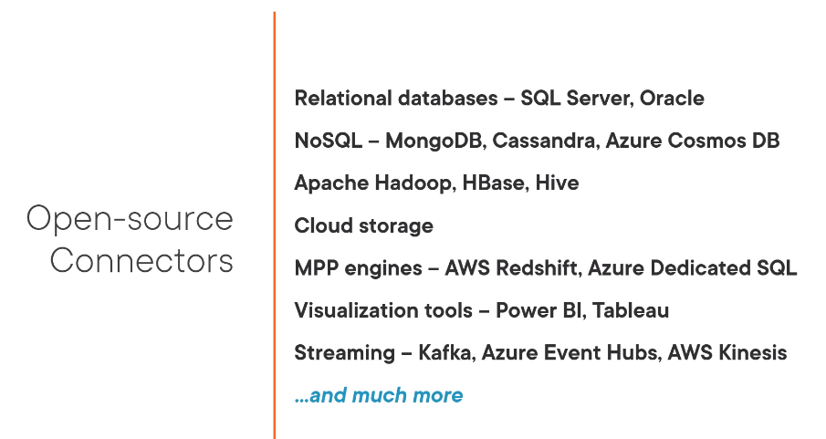
Open-Source Connectors

Slide 5
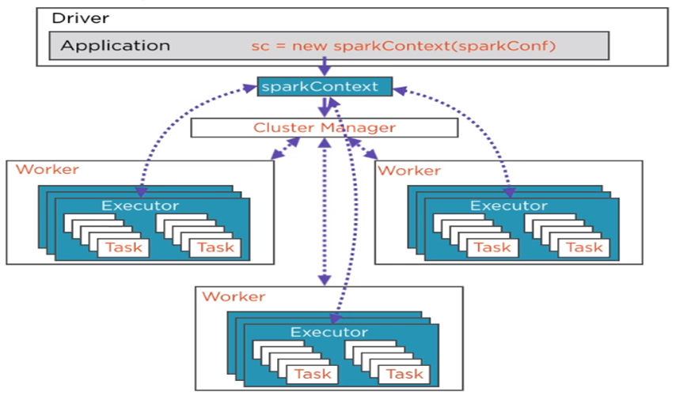
Spark Architecture and Tungsten Engine optimization
The basic architecture is mostly same in Spark 1.x and 2.x, But Tungsten Engine is used in 2.x, that optimizes spark2 10x-20x faster.
Earlier versions of spark used to focus on improving IO and network communication efficiency but since early 2015, disks are getting faster due to SSDs. And Network are getting faster usually with 10GBPS. Only bottleneck seems to be CPU. Hence Tungsten focuses on substantially improving the efficiency of memory and CPU.
Spark used java internally and java makes heavy uses of virtual functions that requires lots of runtime computation that impacts significantly the execution speed. Tungsten completely avoids use of virtual functions.
JVM GC mechanism also prove to be an important and significant bottleneck. Tungsten uses it’s own object creation and garbage control mechanism for better efficiency.

Slide 6


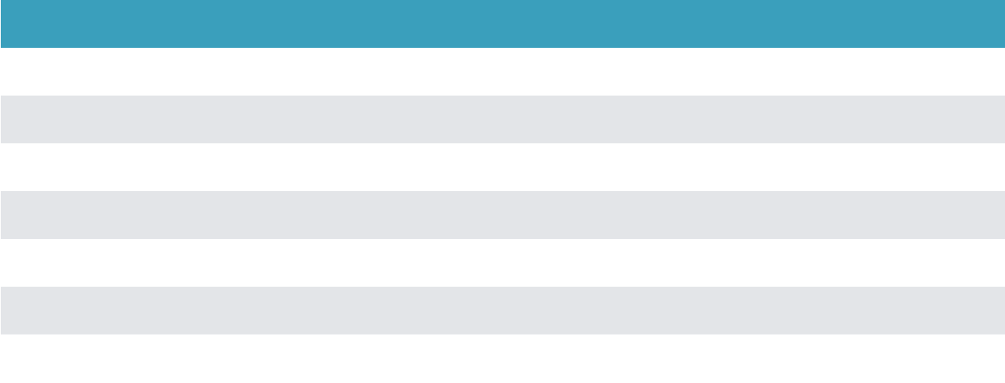
Performance Improvements
Comparison of time per row, on 1 billion records on single thread
Primitive
Spark 1.6
Spark 2.0
Speedup Factor
ﬁlter
15ns
1.1ns
13.6
sum w/o group
14ns
0.9ns
15.6
sum w/ group
79ns
10.7ns
7.4
hash join
115ns
4.0ns
28.8
sort (8-bit)
620ns
5.3ns
117.0
sort (64-bit)
620ns
40ns
15.5
sort-merge-join
750ns
700ns
1.1
Source: https://databricks.com/blog/2016/07/26/introducing-apache-spark-2-0.html

Slide 7

The Spark Programming Abstraction

Slide 8

Resilient Distributed Datasets
An RDD is a collection of entities
- rows, records

Slide 9

Resilient Distributed Datasets
An RDD in Spark is analogous to a
Collection object in Java
It can be assigned to a variable and
methods can be invoked on it
Methods return values or apply
transformations on the RDDs

Slide 10



Characteristics of RDDs
Partitioned
Immutable
Resilient
RDDs, once
Can be
Split across data
created, cannot be
reconstructed even
nodes in a cluster
changed
if a node crashes

Slide 11

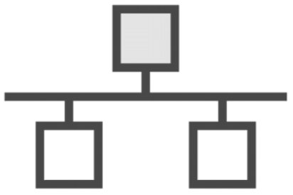

Partitioned
Processing occurs on nodes in parallel
Data is stored in memory for each
node in the cluster

Slide 12


Immutable
An RDD cannot be
mutated
Only two types of operations are permitted on an RDD
Transformation: Transform the RDD to create another RDD
Action: Read data from an RDD

Slide 13
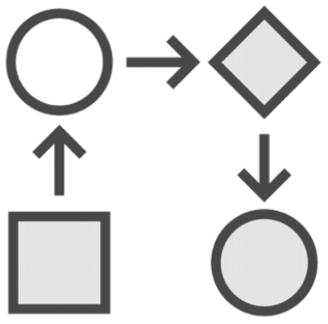

Resilient
RDDs can be
reconstructed even if
the node it lives on
crashes

Slide 14
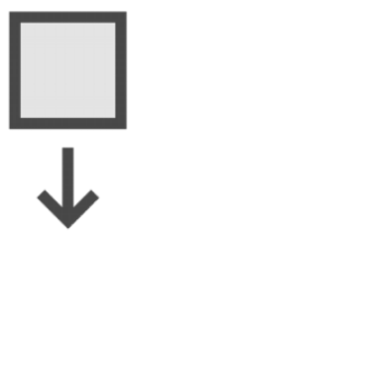
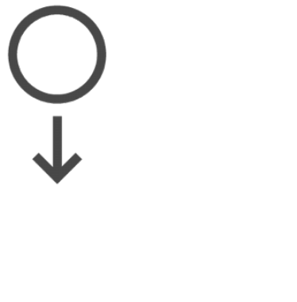
RDDs Are Resilient
Transforming
Reading a ﬁle
another RDD
Every RDD keeps track
of where it came from

Slide 15
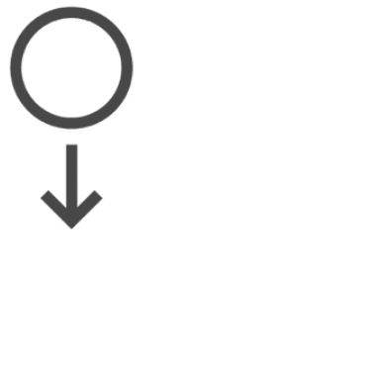
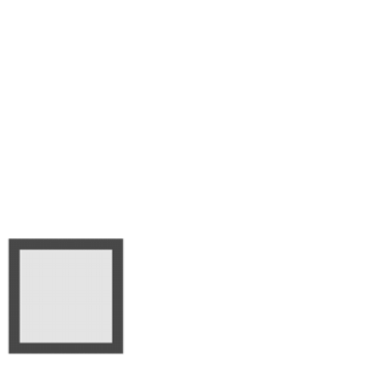


RDDs Are Resilient
It tracks every transformation
which led to the current RDD

Slide 16
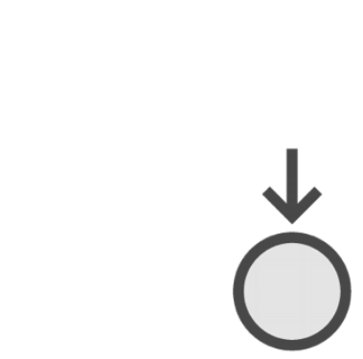

RDDs Are Resilient
However many
transformations it
takes

Slide 17








RDDs Are Resilient
This is the
RDD’s lineage

Slide 18
RDDs Are Resilient
None of the
transformations
are applied till we
access the results

Slide 19
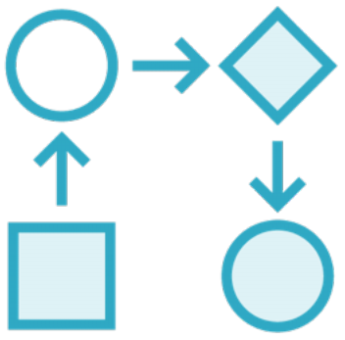
Lineage
Allows RDDs to be reconstructed
when nodes crash
Allows RDDs to be lazily
instantiated when
accessing the results

Slide 20

Demo
Demo
Spark operations on RDDs in the
Pyspark interactive shell

Slide 21
RDD
An RDD simply a immutable resilient distributed collection of elements. Each RDD is split into multiple partitions, which may be computed on different nodes of the cluster.
input = sc.textFile("/home/notroot/datasets/CricketScore.txt") # Read File
a = sc.parallelize([2,1,2,4,5,3,7,6,9,8,9],4)#containing list
b = sc.parallelize([('ST',20),('ST',30),('ST',50),('VK',40),('VK',20),('VK',50)])# Key Value RDDs
b.collect() //To see the rdd content
b.keys().collect() #Find all Keys
b.values().collect() #Find all values
a.getNumPartitions()
sc.defaultParallelism #To check the default partitions,

Slide 22
RDD Operations
Once created, RDDs offer two types of operations: transformations and actions.
Transformations returns new RDD. Spark keeps track of the set of dependencies between different RDDs, called the lineage graph and used it to if part of a persistent RDD is lost.
Action kicks off computation and returns result to driver or write it to storage.
To enable TAB completion in pyspark prompt, execute below.
import rlcompleter, readline
readline.parse_and_bind("tab: complete")
To make sure this setting is persistent, Create a file .pythonrc, then in your .bashrc file, add
export PYTHONSTARTUP=~/.pythonrc

Slide 23
Transformation
map
a.map(lambda x: x *x).collect()
flatMap
a.flatMap(lambda x: range(x,5)).collect()
Distinct
b.distinct().collect() #works on Key Value RDD also
Filter
a.filter(lambda x : x%2 ==0).collect()
Sampling
a.sample(False,0.2).collect()
MapVales
b.mapValues(lambda x: x +1).collect()
FlatMapValues
b.flatMapValues(lambda x: range(x, 30)).collect()

Slide 24
Transformation
#Union
a = sc.parallelize([1,2,3])
b = sc.parallelize([3,4,5])
a.union(b).collect()
Intersection,
a.intersection(b).collect()
Subtraction
a.subtract(b).collect()
Cartesian
a.cartesian(b).collect()
zip
a.zip(b).collect()

Slide 25
Transformation
#sortBy - Sorts this RDD by the given keyfunc
sorted(a.map(lambda x: x).collect())
a.sortBy((lambda x: x),False).collect()
b.sortBy(lambda x: x[0]).collect()
b.sortByKey(True).collect()
#groupBy
a.groupBy(lambda x : (x)).collect()
a.groupBy(lambda x : (x)). map(lambda x : (x[0], list(x[1]))).collect()
a.groupBy(lambda x : ("even" if (x % 2 == 0) else "odd" )).map(lambda x : (x[0], list(x[1]))).collect() #using map
a.groupBy(lambda x : (x % 2 == 0)).mapValues(list).collect() #mapValues

Slide 26
Transformation
Cogroup
functions that allow grouping up to 3 key-value RDDs using their keys
x = sc.parallelize([(1, "apple"), (2, "banana"), (3, "orange"), (4, "kiwi")])
y = sc.parallelize([(5, "computer"), (1, "laptop"), (1, "desktop"), (4, "iPad")])
x.cogroup(y).map(lambda x: (x[0], list(x[1][0]), list(x[1][1]))).collect()
KeyBy
(used to create key value RDD)
sc.parallelize(["dog", "salmon", "salmon", "rat"]).keyBy(lambda x : len(x)).collect()

Slide 27
Transformation
reduceByKey
from operator import add
a = sc.parallelize([('ST',20),('ST',30), ('VK',20),('ST',50),('VK',40),('VK',50), ('ST',20),('VK',50)],3)
a.reduceByKey(add).collect()
foldByKey
a.foldByKey(2,add).collect()
Initial value for each key per partition and but not driver, check a.glom().collect() to see the keys in each partition.
groupByKey
a.groupByKey().map(lambda x:(x[0],sum(list(x[1])))).collect()
aggregateByKey [Pair]
a.glom().collect()[0], a.glom().collect()[1] #lets have a look at what is in the partitions
a.aggregateByKey(10,lambda acc,val: acc+val, lambda acc1, acc2:acc1+acc2).collect()
reduceByKey and aggregateByKey are much more efficient than groupByKey.

Slide 28
Transformation
combineByKey() is the most general per-key aggregation functions. It has three functions.
createCombiner() to create the initial value for the accumulator on that key.
mergeValue() to merge the current value for the key and the new value in partition
mergeCombiners() function to merging the results from each partition
a.combineByKey(lambda value: (value, 1), lambda x, value: (x[0] + value, x[1] + 1), lambda x, y: (x[0] + y[0], x[1] + y[1]))
Find Average Score each player using combineByKey()
b = input.map(lambda x:(x.split("\t")[0],int(x.split("\t")[1])))
c = b.combineByKey(lambda value: (value, 1), lambda x, value: (x[0] + value, x[1] + 1), lambda x, y: (x[0] + y[0], x[1] + y[1]))
#c.map(lambda x: (x[0], x[1][0] / x[1][1])).collect()
c.mapValues(lambda x: x[0]/x[1]).collect()

Slide 29
Transformation
Join
a = sc.parallelize([(1,2),(3,4),(3,6)])
b = sc.parallelize([(3,9)])
a.join(b).collect()
Left Join
a.leftOuterJoin(b).collect()
Right Join
a.rightOuterJoin(b).collect()
Full Join
a.fullOuterJoin(b).collect()
SubtractByKey
a.subtractByKey(b).collect()

Slide 30
Execute Spark Sample Program
Create totalscore.py file as below.
from pyspark import SparkContext
sc = SparkContext(appName = "TotalScore")
text_file = sc.textFile("/home/notroot/datasets/CricketScore.txt")
counts = text_file.map(lambda x:(x.split("\t")[0],int(x.split("\t")[1]))).reduceByKey(lambda a, b: a + b)
counts.saveAsTextFile("/home/notroot/Output/")
spark-submit --master local[8] totalscore.py
Runs application locally on 8 cores,
In case of yarn cluster
spark-submit --master yarn --executor-memory 5G --num-executors 10 totalscore.py

Slide 31
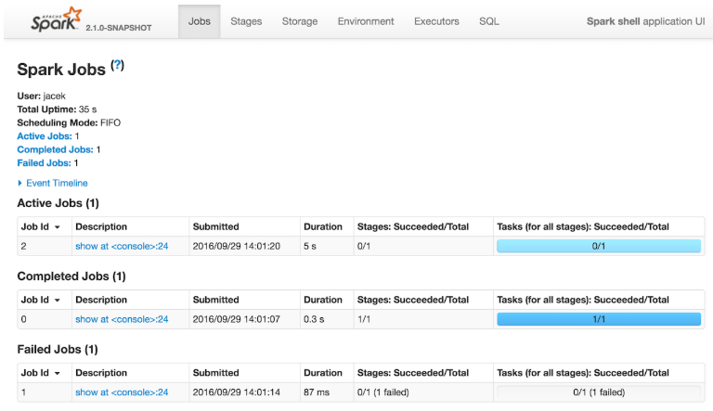
Web UI-Spark Application’s Web Console
Web UI is the web interface of a Spark application to monitor and inspect Spark job executions in a web browser.

Slide 32
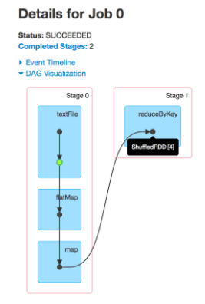
Execution DAG
web UI comes with the following tabs (which may not all be visible immediately, but only after the respective modules are in use, e.g. the SQL or Streaming tabs):
Jobs
Stages
Storage
Environment
Executors
Execution DAG
The second visualization addition to the latest Spark release displays the execution DAG for each job. In Spark, a job is associated with a chain of RDD dependencies organized in a direct acyclic graph (DAG) that looks like the following:
You can use the web UI after the application has finished by persisting events.

Slide 33
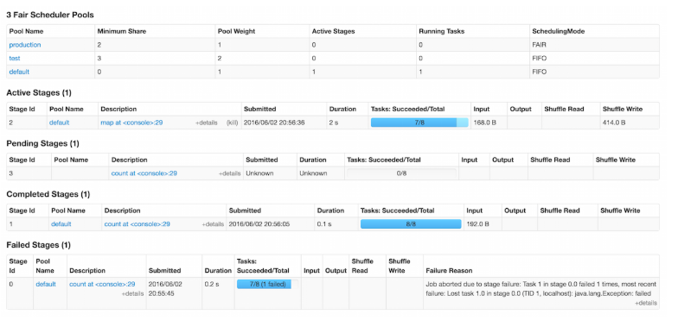
Stages
The Stages tab is available under /stages URL, i.e. http://localhost:4040/stages.
Internally, the Stages tab is represented by StagesTab.

Slide 34
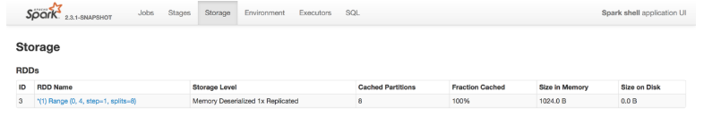
Storage Tab
The Storage tab is available under /storage URL, i.e. http://localhost:4040/storage.
Internally, the Storage tab is represented by StorageTab.

Slide 35
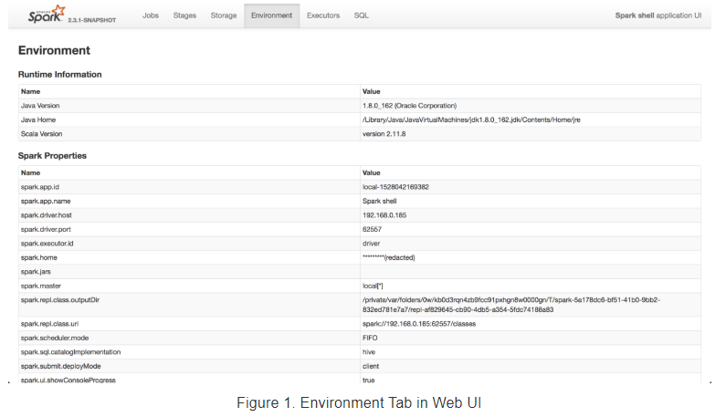
Environment Tab

Slide 36
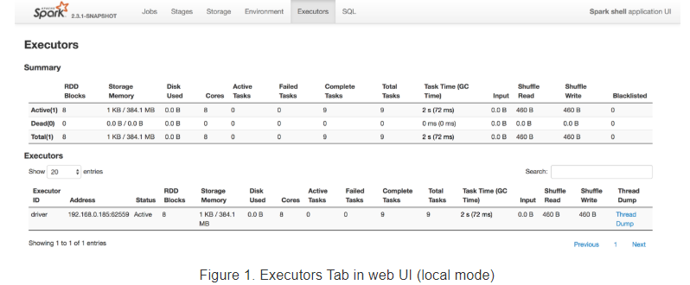
Executors Tab
The Executors tab is available under /executors URL, i.e. http://localhost:4040/executors.
Internally, the Executors tab is represented by ExecutorsTab.

Slide 37
Partition transformation
spark.default.parallelism defaults to the number of all cores on all machines.
The base RDD has no parent RDD to determine number of partitions, so it uses the spark.default.parallelism.
#Map Partition (Working with per partition data)
a.glom().collect() #see data from each partition
def show(x): yield list(x)
a.mapPartitions(show).collect() #see each partition data
def total(iterator): yield sum(iterator)
a.mapPartitions(total).collect() #sum each partition data
#mapPartitionWithIndex
def total(i, x): yield 'partition: '+str(i)+" values: "+ str(list(x))
a.mapPartitionsWithIndex(total).collect()

Slide 38
Coalesce/Repartition
Coalesce transformation is used to reduce the number of partitions.
b = a.coalesce(3,True) //Data Shufle
c = a.coalesce(3,False) #coalesce doesn't guarantee empty partitions will be removed.
b = a.repartition(7) #Repartition: Reshuffle the data to increase or decrease
repartitionAndSortWithinPartitions (Repartition the RDD according to the given partitioner and, within each resulting partition, sort records by their keys.)
rdd1 = sc.parallelize([(0, 5), (3, 8), (2, 6), (0, 8), (3, 8), (1, 3)])
rdd2 = rdd1.repartitionAndSortWithinPartitions(2, lambda x: x % 2)
rdd2.glom().collect()
Monitor Spark Jobs
http://192.168.152.139:4040/jobs/ (Localhost generally don’t work, use machine ID as host.)

Slide 39
Actions
b = sc.parallelize([(1, "dog"), (3, "tiger"), (2, "lion"), (4, "cat"),(4, "Mouse")])
Take
a.take(5)
Top
a.top(5)
Take Ordered
rdd.takeOrdered(4)
a.takeOrdered(1, key=lambda x: -x) #Descending. Similar to rdd.top(1)
b.takeOrdered(5, key = lambda x: x[0]) #In (K,V) RDD, Sort by Key
Count
a.count()
CountByValue
a.countByValue()

Slide 40
Actions
First
a.first()
Max
a.max()
Min
a.min()
Reduce
a.reduce(lambda a,b : a + b) #perform aggregations like sum/count of elements in RDD
Fold
a.fold(1,lambda a,b: a + b) #takes a initial value including each partition and driver.

Slide 41
Actions
Aggregate
a.aggregate((1, 1), (lambda x, y: (x[0] + y, x[1] + 1)), (lambda x, y: (x[0] + y[0], x[1] + y[1])))
CountByKey
b.countByKey()
Lookup
b.lookup('ST')
CollectAsMap
b.collectAsMap()
It will overwrite the last value found for a key

Slide 42
Accumulator
Shared variable, accumulators, used for aggregating values from worker nodes back to the driver program. One of the most common uses of accumulators is to count events that occur during job execution for debugging purposes.
Note that tasks on worker nodes cannot access the accumulator’s value()as accumulators are write-only variables.
accumodd = sc.accumulator(0)
accumeven = sc.accumulator(0)
sc.parallelize([1, 2, 3, 4,5,6,7],2).foreach(lambda x: {accumeven.add(1) if (x%2==0) else accumodd.add(1)})
accumeven.value
accumodd.value

Slide 43
Broadcast
Shared variable, broadcast variables, allows the program to efficiently send a large, read-only value to all the worker nodes for use in one or more Spark operations.
brc = sc.broadcast([100,200])
a = sc.parallelize([10,20,30,40,50],2)
a.map(lambda x: {x + (brc.value[0]) if(x>=30) else x + brc.value[1]}).collect()
For Optimizing Broadcasts, When we are broadcasting large values, it is important to choose a data serialization format that is both fast and compact.

Slide 44
Persist(Cache) RDD
Spark’s RDDs are by default recomputed each time you run an action on them. If you would like to reuse an RDD in multiple actions, you can ask Spark to persist it using RDD.persist().
After computing it the first time, Spark will store the RDD contents in memory (partitioned across the machines in your cluster), and reuse them in future actions. Persisting RDDs on disk instead of memory is also possible.
If a node that has data persisted on it fails, Spark will re-compute the lost partitions of the data when needed. We can also replicate our data on multiple nodes if we want to be able to handle node failure without slowdown.
If you attempt to cache too much data to fit in memory, Spark will automatically evict old partitions using a Least Recently Used (LRU) cache policy. Caching unnecessary data can lead to eviction of useful data and more re-computation time.
RDDs come with a method called unpersist() that lets you manually remove them from the cache.
cache() is the same as calling persist() with the default storage level.

Slide 45
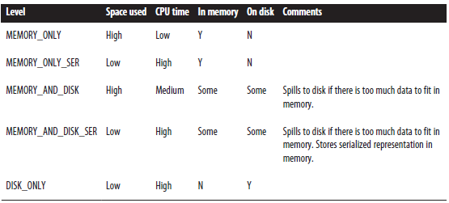
Persist(Cache) RDD

